Slide 1
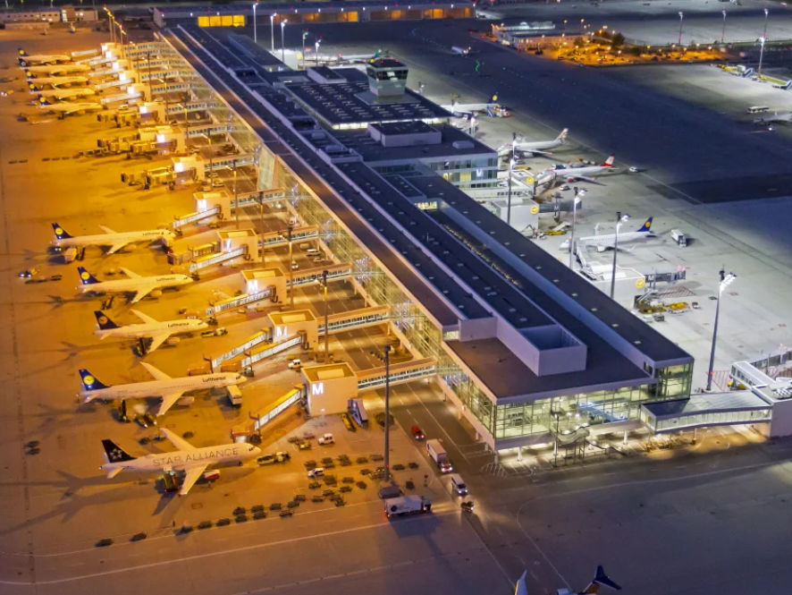
Blockchain & solidity
Project: Flying Coins
Nimra Ayub, Sofia Steinleitner, Ton Thanh Huyen Ha

Slide 2

Problem

Slide 3
Problem
Problem 1
The procedure to claim is complicated and takes a lot of time
Problem 2
Requires a lot of work from customer and the company to check the validity of the claim
Problem 3
Customer might lose their right to claim for the payment if they do not apply for it on time

Slide 4

Solution and Product

Slide 5
Project name: Flying Coins
Insurance as a Smart Contract
Automated fulfillment of the contract
Secured claim

Slide 6
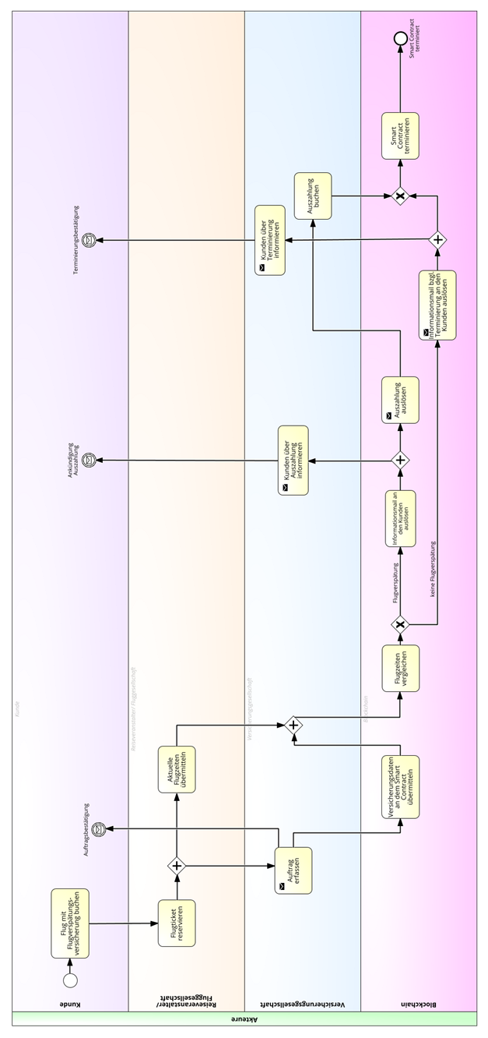
BPMN

Slide 7
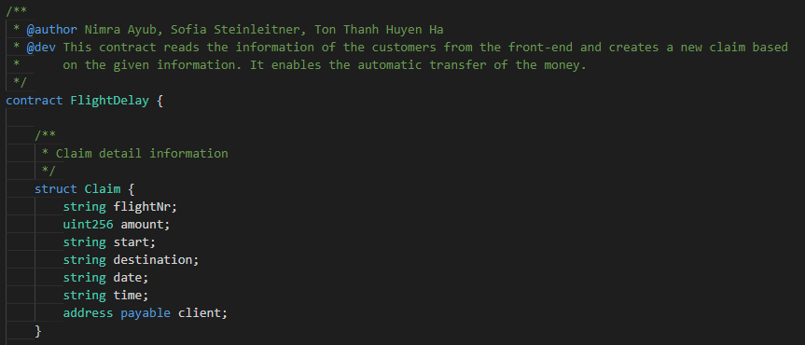
How it works:

Slide 8
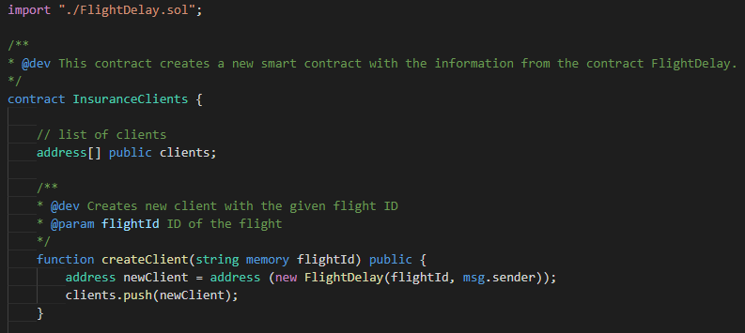
How it works:

Slide 9
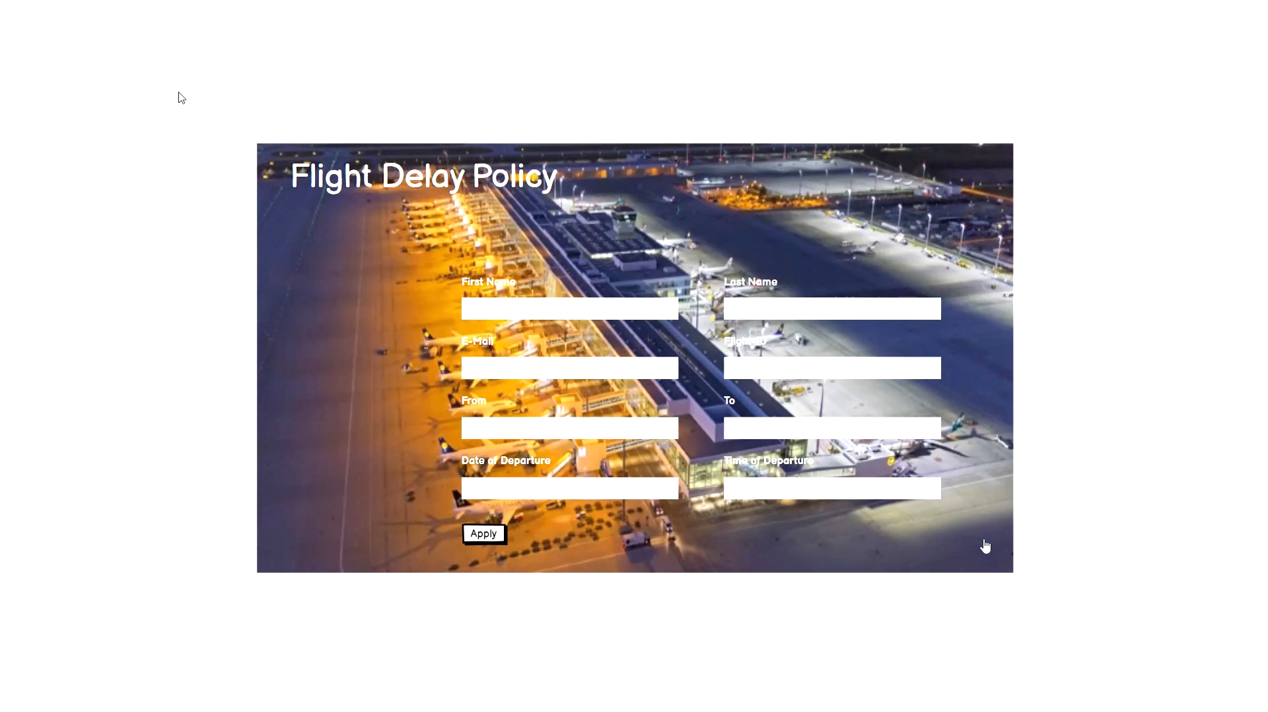
How it works:

Slide 10

MarkEt

Slide 11
Customers
Everyone, who booked a flight.

Slide 12
Thank you for your attention

